Slide 1
NNSA Research Update November 2010
Lonnie Sharpe, Jr., PhD, PE
Massie Chair of Excellence
Tennessee State University
3500 John Merritt Blvd
Suite 415 Crouch Hall
Nashville, Tennessee 37209-1561
615-963-7474
615-963-7492 (fax)
sharpe@coe.tsuniv.edu

Slide 2
Participants
Lonnie Sharpe, Jr., Massie Chair of Excellence, PhD, Mechanical Engineering
Thomas Byl, Civil Engineering Department, PhD, Environmental Chemistry
Roger Painter, Civil Engineering Department, PhD, Chemical Engineering
Nsoki Phambu, Chemistry Department, PhD, Physical Chemistry
Tasneem Siddiquee, Chemistry Department, PhD, Chemistry
Koen Vercruysse, Chemistry Department, PhD, Pharmaceutical Sciences

Slide 3
Student Participants
Ashley West, Civil Engineering, Sophomore
Carlton Cobb, Civil Engineering, Senior
Jaala Brooks, Civil Engineering, Senior
Lolade Akinola, Civil Engineering, MS
Victor Roland, Civil Engineering, MS
James Tyner, Civil Engineering, Senior
Gionnia Maze, Civil Engineering, Senior
Taylor Cappadona, Chemistry, Senior
Sean Mills, Chemistry, Senior
Mahesh Yarlagadda, Chemistry, Junior

Slide 4
Chemical Fate and Detection in the Environment
Fate of Contamination in Non-Ideal Flow Systems
Predict the fate of contaminants in non-ideal flow systems such as karst aquifers and wetlands.
Synthesis of Actininde-Based Nanoparticles
Aims to develop strategies for the synthesis of actinide (Uranium or others) nanoparticles. Such nanoparticles could provide improved means to store, transport and utilize nuclear materials.
Study of Host-guest Interactions by Spectroscopic Techniques
Aims to evaluate the potential of using Raman spectroscopy to study host-guest interaction between pollutant analyte-guest molecules and both commercially available and synthesized host molecules as a precursor to sensor technology.

Slide 5
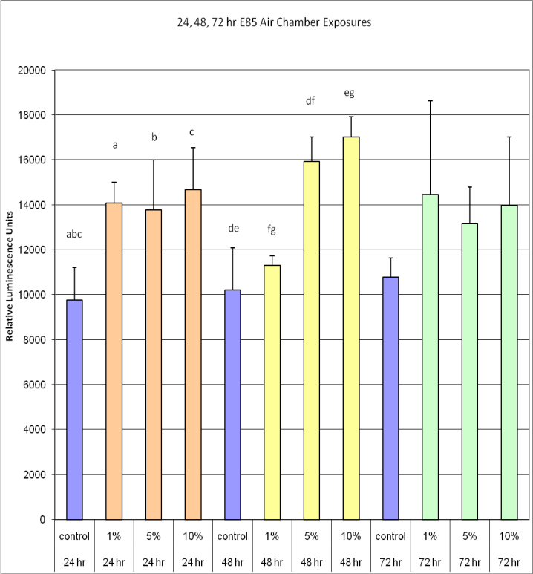
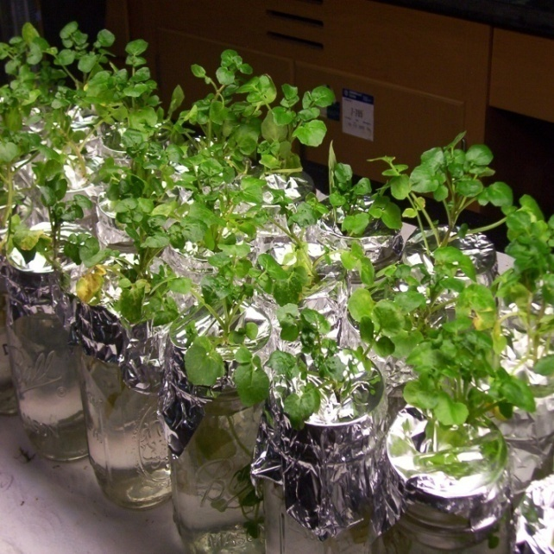
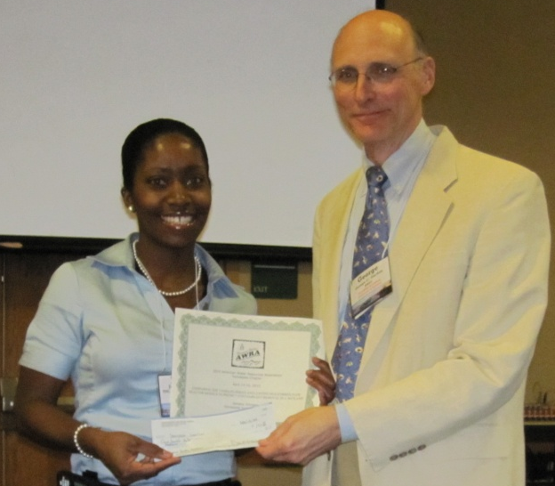
Using Plants to Monitor Air & Water Quality
Statement of Work
Watercress is an ideal sentinel plant because it grows in streams & springs.
It is sensitive to air & water pollution.
Exposure to pollution affects their oxidase enzyme activity.
Obj.- Evaluate the oxidase response in plants after chemical exposure & generate dose-response curves.
Accomplishments
Developed dose-response curves for volatile organic compounds; 1st place AWRA
The oxidative enzyme activity in watercress rises after exposure to Et-85 vapors (response is rapid & dose dependant)

Slide 6
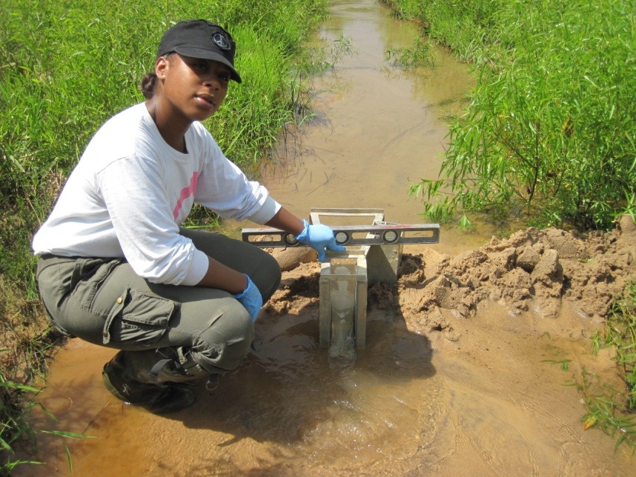
Predicting Contaminant Removal in Non-ideal Flow System
Statement of Work
Conduct tracer studies in non-ideal flow system
Compare the results of different models used to predict fate of contaminants in non-ideal flow systems
Accomplishments
Tracer & contaminant data collected & interpreted
Improved models
Presentation at meetings
Upper
t_{m} = 92 hrs
σ² = 1011
P_{e} = 16.05
d = 0.06
Lower
t_{m} = 117 hrs
σ² = 811
P_{e} =33.7
d = 0.03

Slide 7
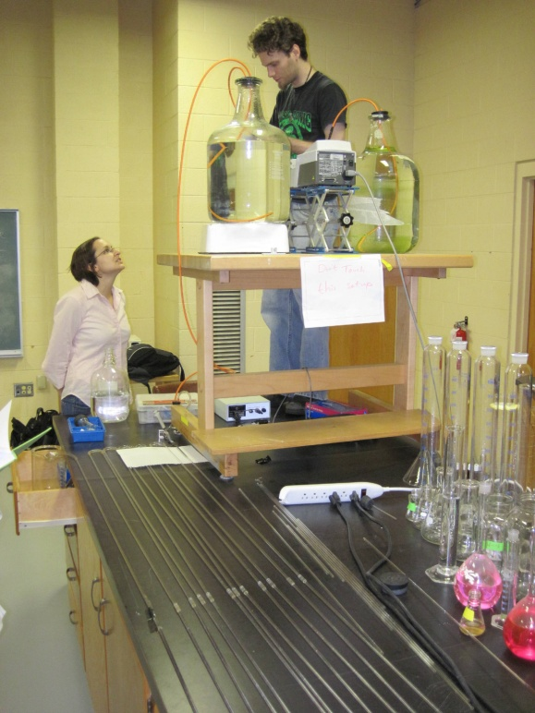
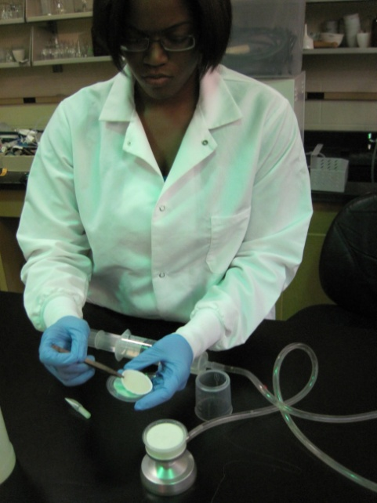
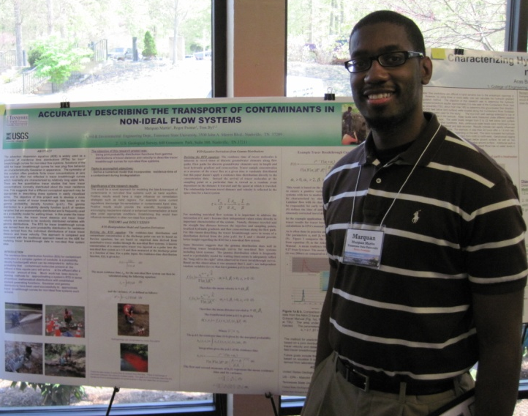
Additional work on detection methods & quantifying non-ideal flow
Statement of Work
Compare traditional to new molecular methods for detecting bacteria in water
Set up lab simulation of non-ideal flow system & quantify advection-dispersion of nano-iron particles
Accomplishments
Traditional detection methods were easier, faster (in our lab)
Nano-particle studies continuing – preliminary study show good agreement between model & lab experiment

Slide 8
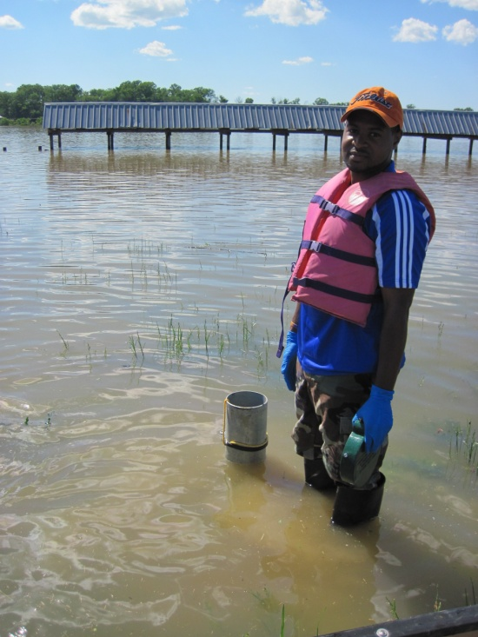
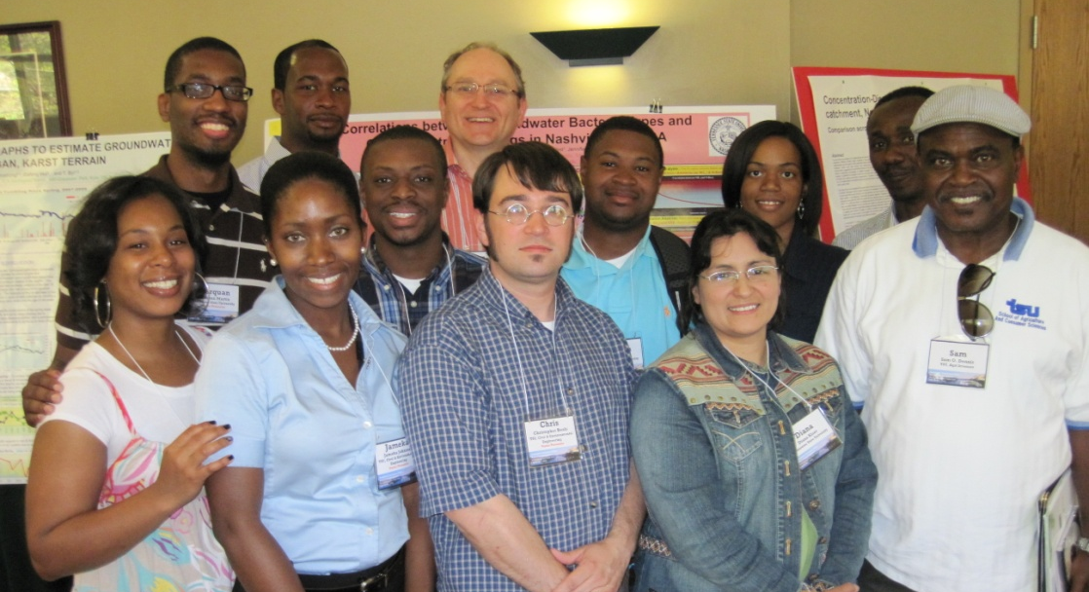
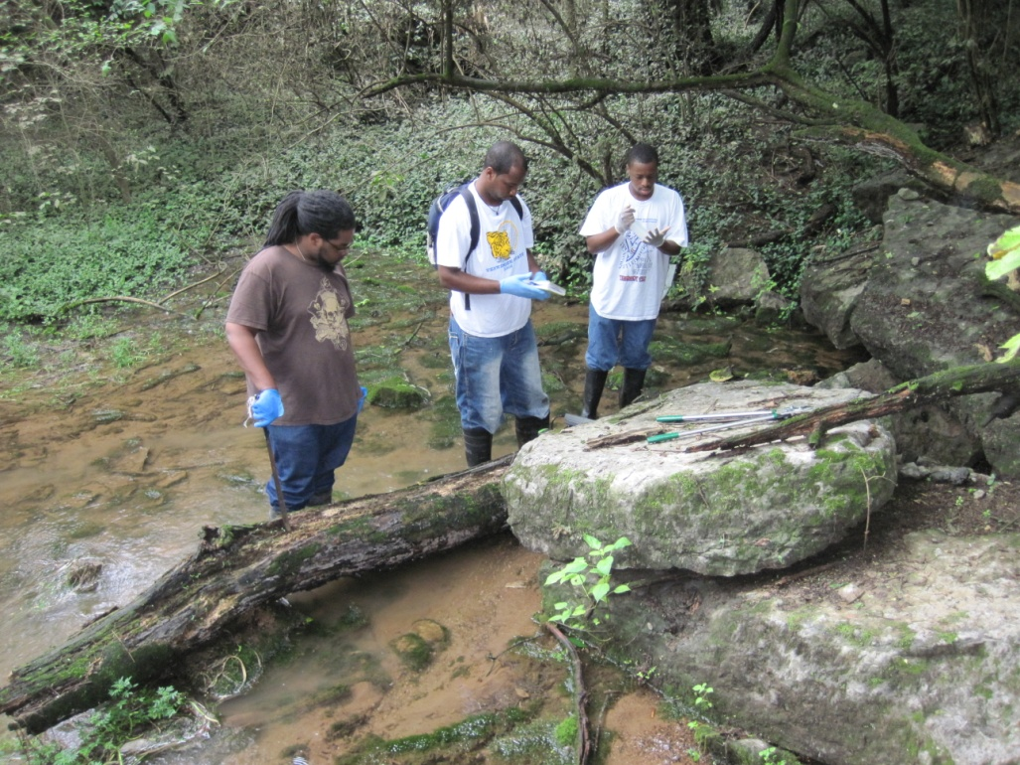
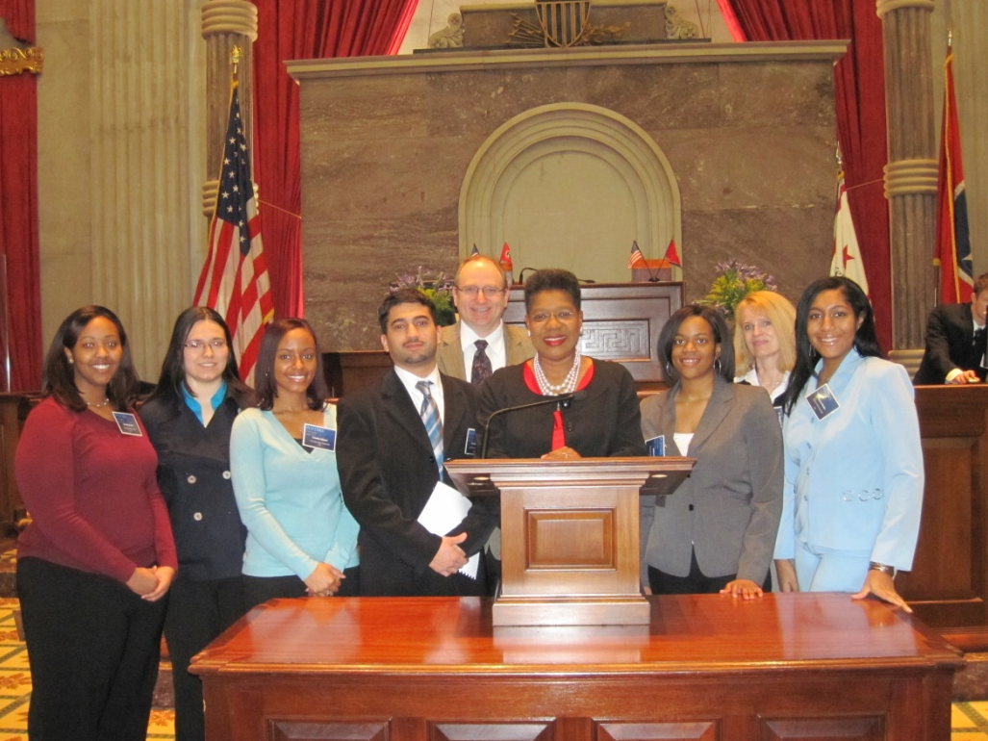
TSU had 10 presentations & won 1st again at the TN AWRA mtg, May 2010
May flood monitoring
Re-establishing monitors after May flood
TSU students invited to present at TN capitol (Rep. B. Gilmore at podium)

Slide 9
Synthesis of Actinide-Based Nanoparticles
Develop strategies for the synthesis of lanthanide based nanoparticles in the first phase of the project.
Use lanthanide elements as models for the actinide elements since the lanthanide elements (the so-called 4f-elements) have similar physical-chemical properties as the actinide elements (the so-called 5f-elements).
Transfer the technology developed for the synthesis of lathanide-based nanoparticles to the synthesis of the actinide-based nanoparticles during the second phase of the project.

Slide 10
NP Accomplishments
Finished first phase of the project:
developed a general strategy to synthesize lanthanide-based nanoparticles, e.g., EuF₃, by mixing the lanthanide cation with a precipitating anion in the presence of polysaccharide.
Started second phase of the project:
Export NP-synthesizing strategy developed for lanthanid-based NPs to uranyl-based NPs.
Develop alternative strategy to synthesize uranyl-based NPs.

Slide 11
NP Accomplishments of Phase 2
Synthesized uranyl-based NPs by mixing UO₂²⁺ with a precipitating anion in the presence of polysaccharide.
Most successful with OH⁻, IO4⁻ or PO₄³⁻ as anion species
Most successful with gum Arabic or carboxymethylcellulose as polysaccharide
Characterization of NPs using UV/vis spectroscopy, dynamic light scattering (DLS) and powder X-ray diffraction (XRD)
Awaiting full characterization by electron microscopy

Slide 12
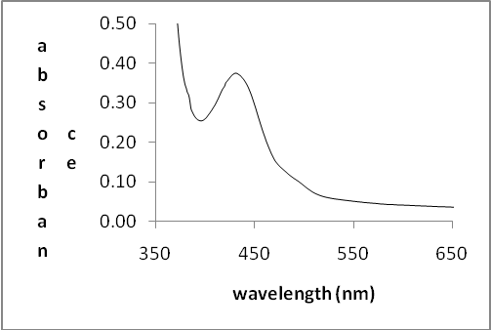
NP Accomplishments of Phase 2 (cont.) UV/vis spectroscopy of UO₂(OH)₂ nanoparticles synthesized in the presence of gum Arabic

Slide 13
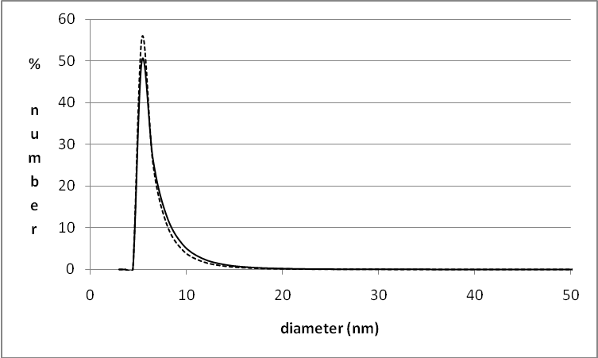
NP Accomplishments of Phase 2 (cont.) DLS analysis results of NPs synthesized in the presence of gum Arabic by mixing UO₂²⁺ and IO₄⁻ (solid line) or PO₄³⁻ (dotted line)

Slide 14
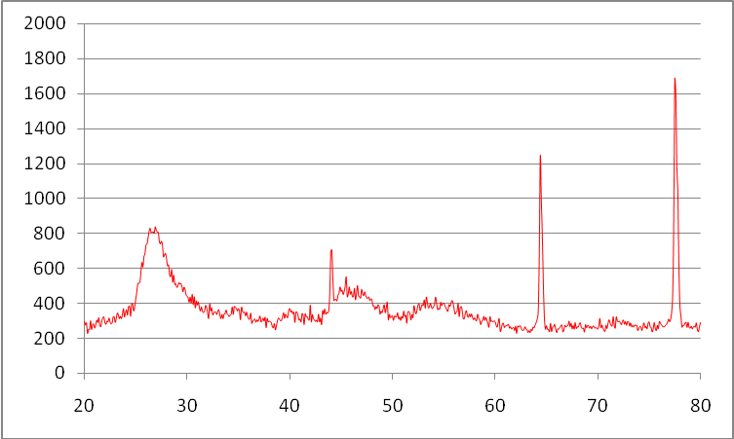
NP Accomplishments of Phase 2 (cont.) Powder XRD scan of UO₂(OH)₂ nanoparticles synthesized using carboxymethylcellulose.
Broad peaks indicated by arrows corresp0nd with UO₂(OH)₂
Narrow peaks observed in spectrum are artefacts.

Slide 15
Study of Host-guest Interactions by Spectroscopic Techniques
Understand and develop molecular systems that may lead to a molecular sensor
For the proof of concept and feasibility studies supramolecular interactions will be studied between commercially available β-cyclodextrin and small molecules with different functional groups. Usual spectroscopic studies will be used to follow the interaction. For possible cases the complex will be crystallized and solid state structural investigation will be undertaken for a deeper understanding.
Synthetic strategy will be developed towards the synthesis of unique host molecule for supramolecular studies
Notes:
15

Slide 16
Sensor Accomplishments
Previously we tried crystallization of supramolecular complexes between β-cyclodextrin and small pesticide molecules. The complex was crystallized from boiling water. The resulting crystallized sample when analyzed revealed the structure of β-cyclodextrin without the pesticide molecule.
It became important to find another system where heating of the sample would not be required for crystallization.
Notes:
16

Slide 17
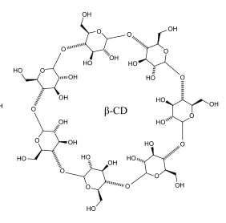
Sensor Accomplishments
To study the interaction in solid state. We had to grow crystalline sample of the host-guest complex for single crystal X-ray crystallography. 4-aminothiophenol (4-ATP) was chosen as the guest molecule and β-cyclodextrin was kept as the host molecule.
Guest
Host (β-cyclodextrin)
Notes:
17

Slide 18
Sensor Accomplishments
Successful crystals were grown and study revealed not only the host-guest interaction between 4-ATP and β-cyclodextrin, but also that the guest, 4-ATP dimerizes by making S-S bond before it forms complex with β-cyclodextrin
Notes:
This structure will be published
18

Slide 19
Y-12 Collaboration
Conducted a technical evaluation of existing liquid waste treatment operations at Y-12 related to the treatment of waste streams containing lithium and potassium compounds, as well as, waste streams containing strontium, neptunium, americium, cesium and plutonium
Made recommendations regarding new waste water treatment technologies to enhance efficiency and removal of contaminants
Identified potential problems due to chemical interactions that may cause treatment process difficulties or safety concerns
Identified synergistic chemical interactions that may lead to new treatment technologies
Awaiting funding for Phase II

